Slide 1

Classification of Classical Music Compositions Using Machine Learning
A Comparative Study of Various Machine Learning Models
By: Arjun Shah

Slide 2
Introduction and Objectives
Objective
Dataset
Key Steps
To classify classical music compositions by composer using machine learning models.
A collection of MIDI files from six composers, including Lully, Scarlatti, Victoria, Alkan, Schubert and Tchaikovsky.
Data preprocessing, feature extraction, model training and evaluation, and ensemble methods.

Slide 3





Dataset Overview
Scarlatti
Victoria
Lully
Alkan
597 Files
333 Files
200 Files
150 Files
Other
411 Files

Slide 4





Data Preprocessing
Inspection and Cleaning
Inspected and cleaned the dataset to ensure data quality.
Feature Extraction
Extracted features like pitch histogram, most common pitch, and average duration.
Feature Expansion
Expanded pitch histogram into separate features (pitch_0 to pitch_11).
Data Balancing
Handled imbalanced data using SMOTE.
Feature Standardization
Standardized numerical features using StandardScaler.

Slide 5

Feature Importance Analysis
1
2
3
Chords
Duration
Pitch
Number of chords in a song.
Average duration of notes.
Pitch histogram values.

Slide 6
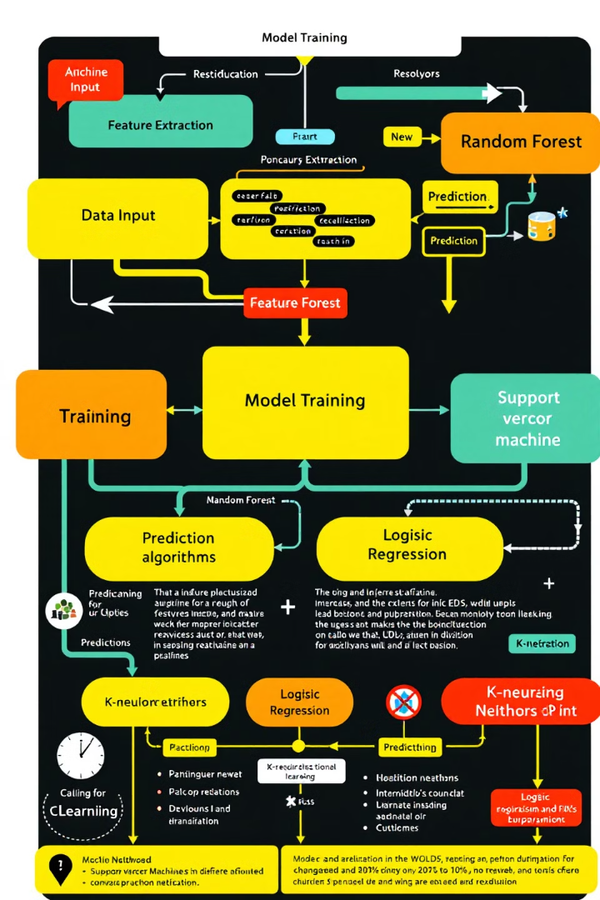
Models Used
1
Random Forest (RF)
2
Support Vector Machine (SVM)
Ensemble learning method that combines multiple decision trees.
Supervised learning model that finds the optimal hyperplane to separate data points.
3
Logistic Regression (LogReg)
4
k-Nearest Neighbors (k-NN)
Statistical method used for binary classification problems.
Non-parametric method that classifies data points based on their proximity to known data points.

Slide 7





Model Evaluation Metrics
Accuracy
Precision
Percentage of correctly classified samples.
Proportion of true positive predictions.
Recall
F1-Score
Proportion of actual positives identified.
Harmonic mean of precision and recall.

Slide 8

Results and Comparisons
Model
Accuracy
Random Forest
92.19%
Stacked Ensemble
92.05%
Gradient Boosting
89.54%
Voting Ensemble
88.01%

Slide 9
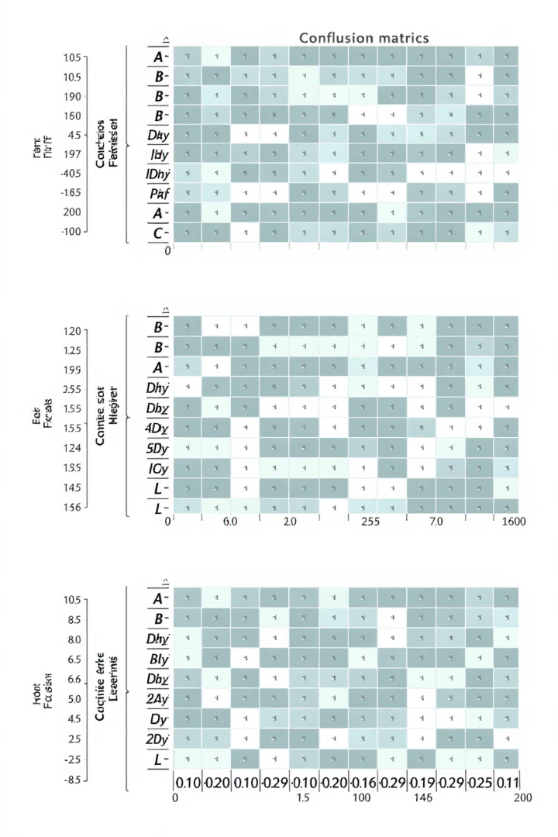
Detailed Model Insights
Random Forest
Gradient Boosting
Accuracy: 92.19%
Accuracy: 89.54%
Highlight: High performance due to ensemble technique.
Highlight: Effective handling of complex patterns.
Stacked Ensemble
Accuracy: 92.05%
Highlight: Combines strengths of multiple models.

Slide 10

Ensemble Techniques
Voting Classifier
Combined RF, GB, and MLP.
Accuracy: 88.01%.
Stacked Ensemble
Combined RF, GB, and MLP with Logistic Regression as the meta-classifier.
Accuracy: 92.05%.

Slide 11



Challenges Faced
Imbalanced Dataset
Hyperparameter Optimization
Computational Costs
Addressed imbalanced dataset using SMOTE.
High computational costs for ensemble models.
Optimized hyperparameters for multiple models using GridSearchCV.

Slide 12

Conclusion
Best Performers
Ensemble Power
Random Forest and Stacked Ensemble models achieved the highest accuracy.
Combining multiple models effectively enhances overall performance.
Data Importance
Thorough data preprocessing and feature extraction are crucial for model success.

Slide 13



Acknowledgments
Thank you to my mentor and collaborators for their guidance and support.
I am grateful for the resources and knowledge shared by experts in the field.

Slide 14

Q&A
Thank you for your time and attention. I'm happy to answer any questions you may have.

